Slide 1
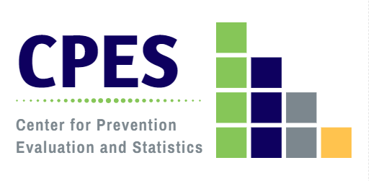
2022 Connecticut Community Readiness Survey Results: Region 2 South Central Alliance for Prevention and Wellness
Developed by the Department of Mental Health and Addiction Services
Center for Prevention Evaluation and Statistics at UConn Health
August, 2022

Slide 2
Connecticut Community Readiness Survey (CRS) Objectives
Assess perceived substance use problems at the local level;
Measure community readiness for prevention and health promotion:
Community attitudes about alcohol and drug use, mental health promotion, and suicide and problem gambling prevention;
Community support for prevention;
Perceived barriers to substance misuse prevention;
Rating of community readiness;
Develop a tool and methodology that DMHAS can use:
For ongoing needs assessment;
To inform substance misuse prevention planning and mental health promotion at state and regional levels;
To identify needs for training and technical assistance;
To provide data to evaluate the impact of SPF-based initiatives.

Slide 3
Connecticut Community Readiness Survey (CRS) Approach
Instrument developed through a consensus process involving DMHAS, its Resource Links, and UConn Health/CPES;
Administered biannually statewide since 2006;
Web-based survey implementation;
CT Clearinghouse coordinates e-mail distribution of the survey;
Regional Behavioral Health Action Organizations identify 5-10 key informants per town/city to survey;
RBHAOs conduct active outreach and follow up with key informants to encourage participation and maximize responses;
Response tracking and data analysis by the DMHAS Center for Prevention Evaluation and Statistics at UConn Health;
State and regional results are disseminated to RBHAOs to support planning;
This approach resulted in 1202 responses to the 2022 CRS survey statewide, a 76.6% response rate based on the established key informant survey sample, with representation in all 169 Connecticut communities.
Notes:
Missing Andover, Hampton and East Granby
Response rate: ~60%

Slide 4
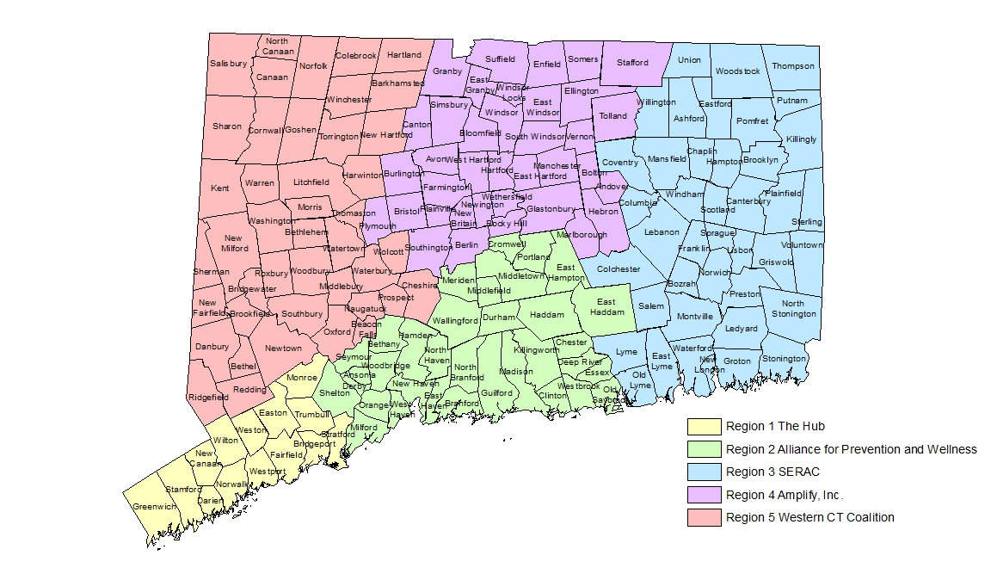
DMHAS Regional Behavioral Health Action Organizations (RBHAOs)
NOTE:
Lyme and Old Lyme have been included in Region 3 for the purposes of this report.

Slide 5
Key Informant Demographic Characteristics: APW CRS, 2022
n=370
Age
Gender
Race
* Includes Gender-neutral and Transgender
Notes:
Unweighted percents

Slide 6
Key Informant Stakeholder Affiliation: APW CRS, 2022
* Personal or family experience with mental illness, substance misuse, or problem gambling
Notes:
Unweighted percents

Slide 7
Substance Misuse

Slide 8
Problem Substances of Greatest Concern for Age Groups, According to Key Informants: APW CRS, 2022
Notes:
Weighted percents

Slide 9
Community Attitudes Toward Substance Misuse Prevention [Q15]: APW CRS, 2022
Key Informant believes that most community residents ….
Notes:
Weighted means

Slide 10
Community Attitudes Toward Substance Misuse Prevention [Q15]: APW CRS, 2022
Key Informant believes that most community residents ….
*including increased access, decreased perception of risk/harm, and changes in social/family norms
Notes:
Weighted means

Slide 11
Perceived Barriers/Assets to Substance Misuse Prevention Activities in the Community [Q18]: APW CRS, 2022
Notes:
Weighted percents

Slide 12
Mental Health

Slide 13
Mental Health Issue of Greatest Concern for Age Groups, According to Key Informants: APW CRS, 2022
Notes:
Weighted percents

Slide 14
Community Attitudes Toward Mental Health [Q16]: APW CRS, 2022
Key Informant believes that most community residents ….
*services, supports and linkages
Notes:
Weighted means

Slide 15
Perceived Barriers/Assets to Mental Health Promotion Activities in the Community [Q19]: APW CRS, 2022
Notes:
Weighted percents

Slide 16
Suicide

Slide 17
In your opinion, how much community support is there for suicide prevention efforts? [Q25]: APW CRS, 2020-2022
Notes:
Weighted percents

Slide 18
How would you rate your community’s ability to implement suicide prevention efforts? [Q26]: APW CRS, 2020-2022
Notes:
Weighted percents

Slide 19
Awareness of Suicide Prevention Supports in Place in the Community [Q27]: APW CRS, 2022
Key Informant awareness that the following are in place in the community….
Notes:
Weighted means

Slide 20
Problem Gambling

Slide 21
Perceived Age Group of Greatest Concern for Problem Gambling Behaviors and Effects, According to Key Informants [Q14]: APW CRS, 2022
Notes:
Weighted percents

Slide 22
Community Attitudes Toward Gambling and Gaming [Q17]: APW CRS, 2022
Key Informant believes that most community residents ….
*sports betting, online casino gambling, and online lottery
Notes:
Weighted means

Slide 23
How important is it to prevent problem gambling/gaming addiction in your community? [Q20]: APW CRS, 2020-2022
Notes:
Weighted percents

Slide 24
How would you rate your community’s ability to raise awareness about the risks of problem gambling/gaming addiction? [Q21]: APW CRS, 2020-2022
Notes:
Weighted percents

Slide 25
How aware are community residents that gambling activities* can become an addiction for some people? [Q22]: APW CRS, 2020-2022
*e.g. scratch-off tickets, lottery, sports betting, Keno, casino games, dice, cards, loot boxes and skins in gaming, etc.
Notes:
Weighted percents

Slide 26
How aware are community residents that there is treatment available for individuals experiencing problems with gambling such as individual and group counseling? [Q23]: APW CRS, 2022
Notes:
Weighted percents

Slide 27
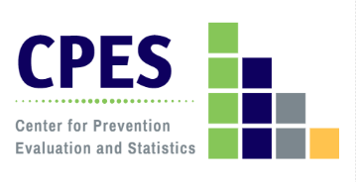
How aware are community residents that there are resources available for persons affected (significant others, spouses, and children) from problem gambling such as individual counseling and support? [Q24]: APW CRS, 2022
Notes:
Weighted percents

Slide 28
Overall Community Readiness

Slide 29
Community Readiness to Undertake Behavioral Health Promotion Activities* [Q28]: APW CRS, 2022
Key Informant believes that the community is ready to….
*Behavioral Health Promotion Activities includes substance misuse prevention and mental health promotion activities.
Notes:
Weighted means

Slide 30
Key Informant Ratings of the Community Stage of Readiness for Substance Misuse Prevention [Q29]: APW CRS, 2022
Community Stage of Readiness for Substance Misuse Prevention: APW (weighted n=195) Mean=5.36 (SD=2.05) | Percent
1 - This town/city tolerates or encourages substance misuse. | 2.1
2 - This town/city has little or no recognition of the substance misuse problem. | 7.6
3 - This town/city believes that there is a substance misuse problem, but awareness of the issue is only linked to one or two incidents involving substance misuse. | 9.4
4 - This town/city recognizes the substance misuse problem and leaders on the issue are identifiable, but little planning has been done to address problems and risk factors. | 20.0
5 - This town/city is planning for substance misuse prevention and focuses on practical details, including seeking funds for prevention efforts. | 13.2
6 - This town/city has enough information to justify a substance misuse prevention program and there is great enthusiasm for the initiative as it begins. | 10.9
7 - This town/city has created policies and/or more than one substance misuse prevention program is running with financial support and trained staff. | 20.7
8 - This town/city views standard substance misuse programs as valuable, new programs are being developed to reach out to at-risk populations and there is ongoing sophisticated evaluation of current efforts. | 11.5
9 - This town/city has detailed and sophisticated knowledge of prevalence, risk factors, and substance misuse program effectiveness and the programming is tailored by trained staff to address risk factors within the community. | 4.7

Slide 31
Key Informant Ratings of the Community Stage of Readiness for Mental Health Promotion [Q30]: APW CRS, 2022
Community Stage of Readiness for Mental Health Promotion: APW (weighted n=196) Mean=5.11 (SD=2.14) | Percent
1 - This town/city is unsupportive of those with mental health issues. | 0.9
2 - This town/city has little or no recognition of the community’s concern about mental health. | 11.6
3 - This town/city believes that mental health concerns impact the community, but awareness of the issue is only linked to one or two situations involving mental health. | 11.8
4 - This town/city recognizes the mental health concerns of the community and leaders on the issue are identifiable, but little planning has been done to address problems and risk factors. | 23.4
5 - This town/city is planning for mental health promotion programs and focuses on practical details, including seeking funds for awareness efforts. | 11.5
6 - This town/city has enough information to justify a mental health promotion program and there is great enthusiasm for the initiative as it begins. | 8.8
7 - This town/city has created policies and/or more than one mental health promotion program is running with financial support and trained staff. | 15.2
8 - This town/city views standard mental health promotion programs as valuable, new programs are being developed to reach out to at-risk populations and there is ongoing sophisticated evaluation of current efforts. | 10.3
9 - This town/city has detailed and sophisticated knowledge of prevalence, risk factors, and mental health promotion program effectiveness and the programming is tailored by trained staff to address risk factors within the community. | 6.6

